Slide 1
EB Programs Optimization Case Study
By
Donald Maisiba Mogaka

Slide 2
Agenda
Current Operations Analysis
Key Bottlenecks
Data Insights (Customers & Operations)
Risk & Budget Analysis
Strategic Initiatives
Project Management Roadmap
Recommendations

Slide 3

Current Operations Overview
Delivery Efficiency = North highest, South lowest
Avg Installation Time = 8 days
Maintenance Requests increasing (esp. North/West)

Slide 4
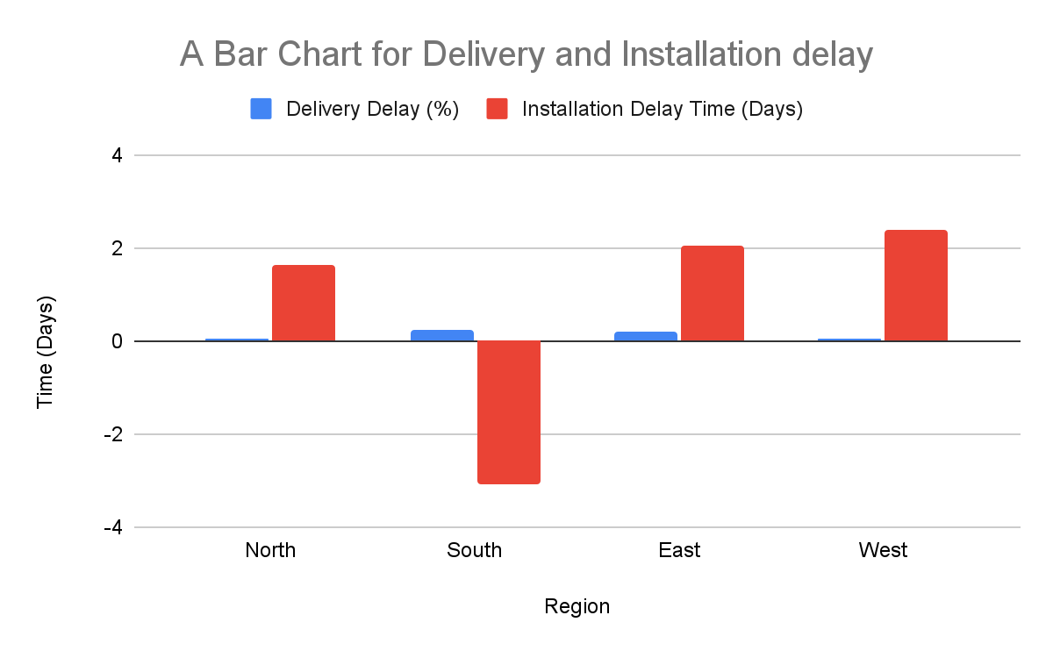
Delivery & Installation Delays
South region has the worst delivery delays; West has highest installation delays

Slide 5
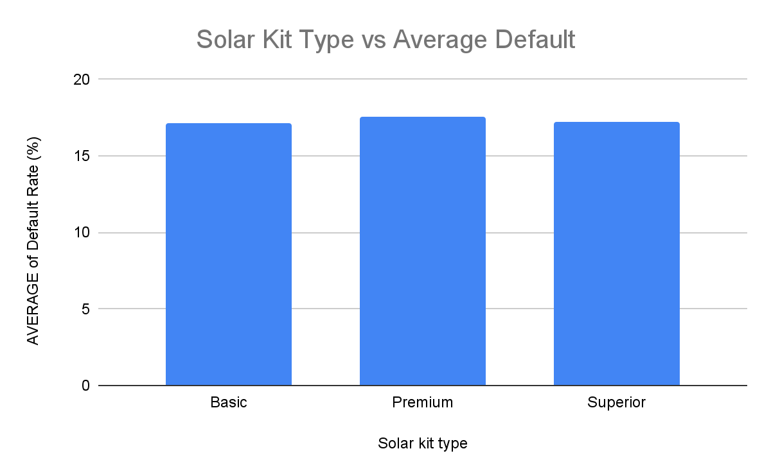
Customer Segment Risk
Premium kit + younger customers show higher default rates.

Slide 6
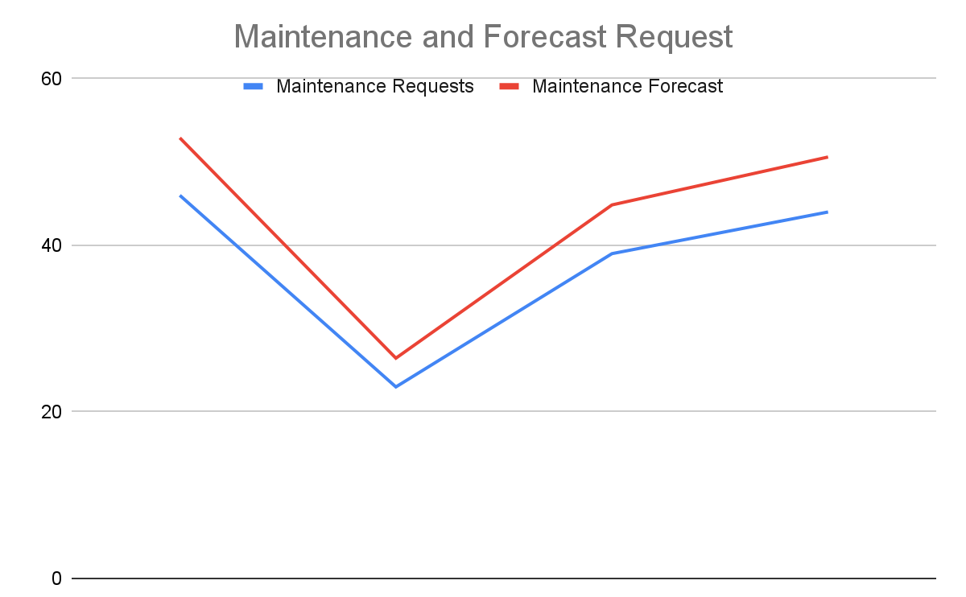
Maintenance Forecast
North & West regions need preventive maintenance resources.

Slide 7
Strategic Initiatives(1/2)
Logistics Optimization → Improve delivery routing & partnerships.
Targeted Credit Screening → Focus on high-risk customer segments.
Predictive Maintenance → AI-based early detection to reduce breakdowns.

Slide 8
Strategic Initiatives (2/2)
Alignment with Sun King goals:
Lower costs by reducing delays.
Increase repayment reliability.
Enhance customer satisfaction.

Slide 9
Roadmap for Implementation
Q1 → Launch logistics pilot in South region.
Q2 → Roll out credit-risk tools.
Q3 → Deploy predictive maintenance in West & North.

Slide 10
Risk Management
Supply chain disruptions
Rising installation labor costs
Customer defaults
Mitigation: Supplier diversification, contractor training, micro-credit support.

Slide 11
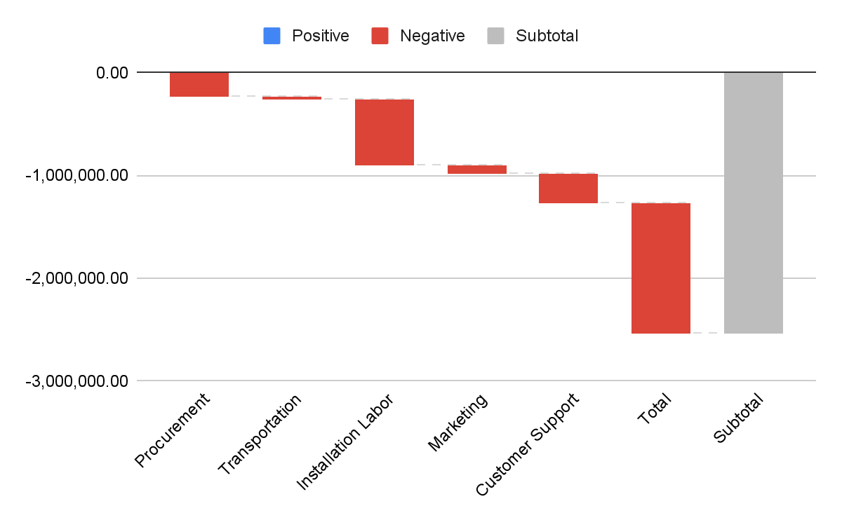
Budget Deficit Analysis
Deficit mainly from installation labor & customer support overspend.

Slide 12
Trade off:
Budget Reallocation Plan
Reallocate marketing & procurement savings to cover labor overspend
Slightly slower growth campaigns vs. guaranteed program delivery.

Slide 13
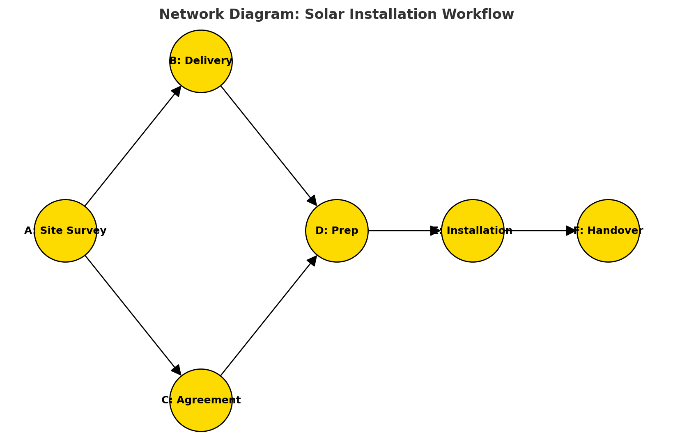
Project Management (North Region)
Parallelize prep tasks & subcontract for efficiency.

Slide 14
Team & Stakeholder Management
Stakeholder Communication:
Monthly updates with KPIs + risks.
Additional funding request supported by efficiency metrics.
Action Plan:
Weekly cross-functional sync (Sales, Ops, Support).
Shared project tracker for transparency.

Slide 15
Recommendations & Conclusion
Sun King can scale efficiently with targeted operational improvements.
Key Takeaway:
Focus on South & East regions for delays.
Strengthen customer credit screening.
Offset budget overspend with savings plan.
Proactive team alignment & reporting.

